Slide 1

Insights from air-bnb, nyc pre-covid period
For data analysis managers &
lead data analyst
BY :
NIKHIL KUMAR SINGH

Slide 2
agenda
Objective
Background
Key findings
Recommendations
Appendix:
Data sources
Data methodology
Data model assumptions

Slide 3
objective
Improve our strategy to minimize the economic and commercial effects of COVID – 19 on AIR-BNB, New York City.
Understand client preferences and trends in user experience for AIR-BNB in New York City.
Provide early recommendations for fresh acquisitions and customer experience enhancement.

Slide 4
background
FOR THE PAST FEW MONTHS AIR-BNB HAS SEEN A MAJOR DECLINE IN IT’S REVENUE.
THE COVID – 19 PANDEMIC AFFECTED AIR-BNB BUSINESS DUE TO TRAVLE RESTRICTIONS.
RESTRICTIONS HAVE STARTED LIFTING AND PEOPLE HAVE STARTED TO TRAVEL MORE AND THUS A THOROUGH ANALYSIS WAS NEEDED TO RECOVER THE LOSSES INCURRED.

Slide 5
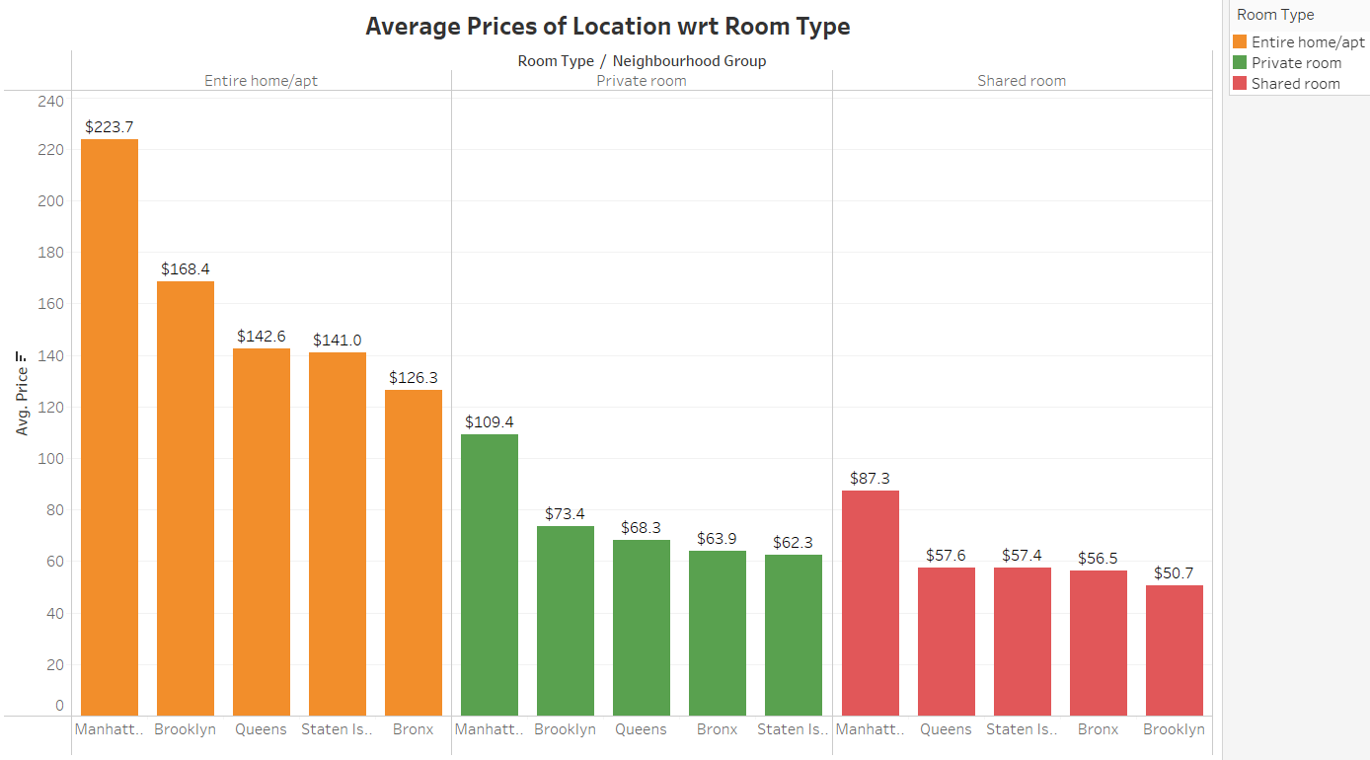
Average Prices of Location w.r.t Room Type
Average price of Manhattan is highest among all the room type.
For shared room type Brooklyn has the lowest average price whereas if we look at the entire home/apt and private room type Brooklyn is second highest in terms of average price.
Queens, Staten Island and Bronx have approximately equal average prices in all room type.

Slide 6
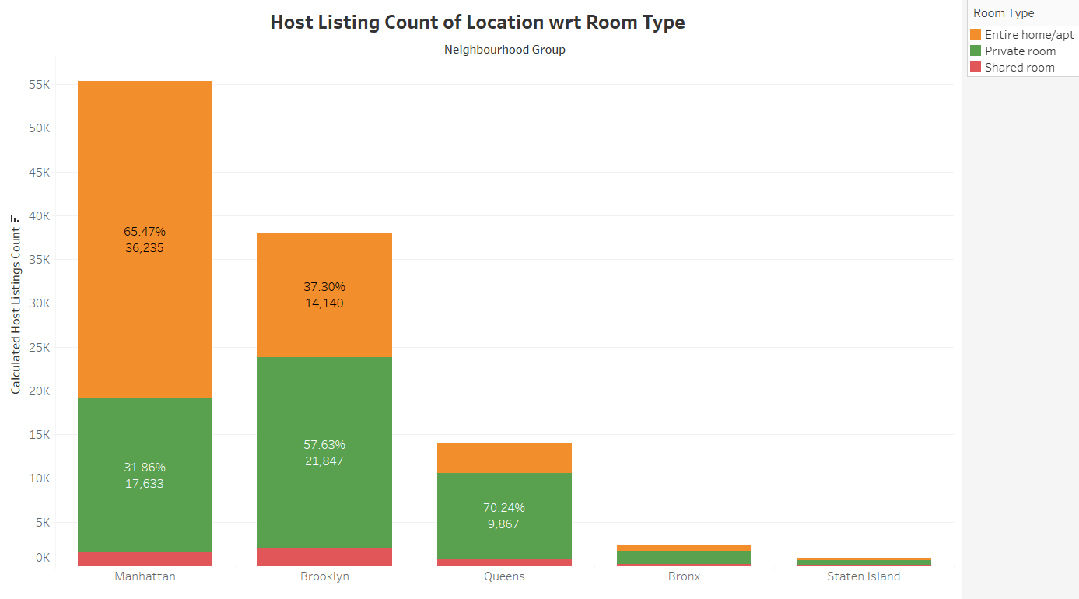
Host listing count of location w.r.t room type
Amount of listings per host is highest in Manhattan followed by Brooklyn.
Entire home/apt has more amount of listings in Manhattan but for Brooklyn & Queens Private room has more amount of listings per host.
Bronx & Staten Island has very less amount of listings per host.

Slide 7
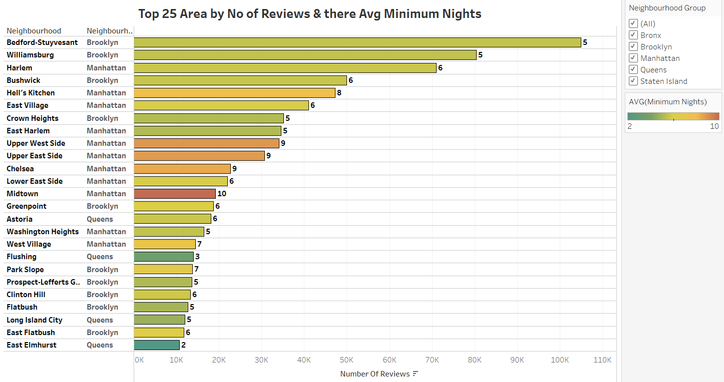
Top 25 area by no of reviews & there avg minimum nights
Bedford-Stuyvesant (Brooklyn) has the highest No of Reviews.
Average amount of minimum nights is highest in Midtown (Manhattan).
No area of Bronx & Staten Island location is under Top 25.

Slide 8
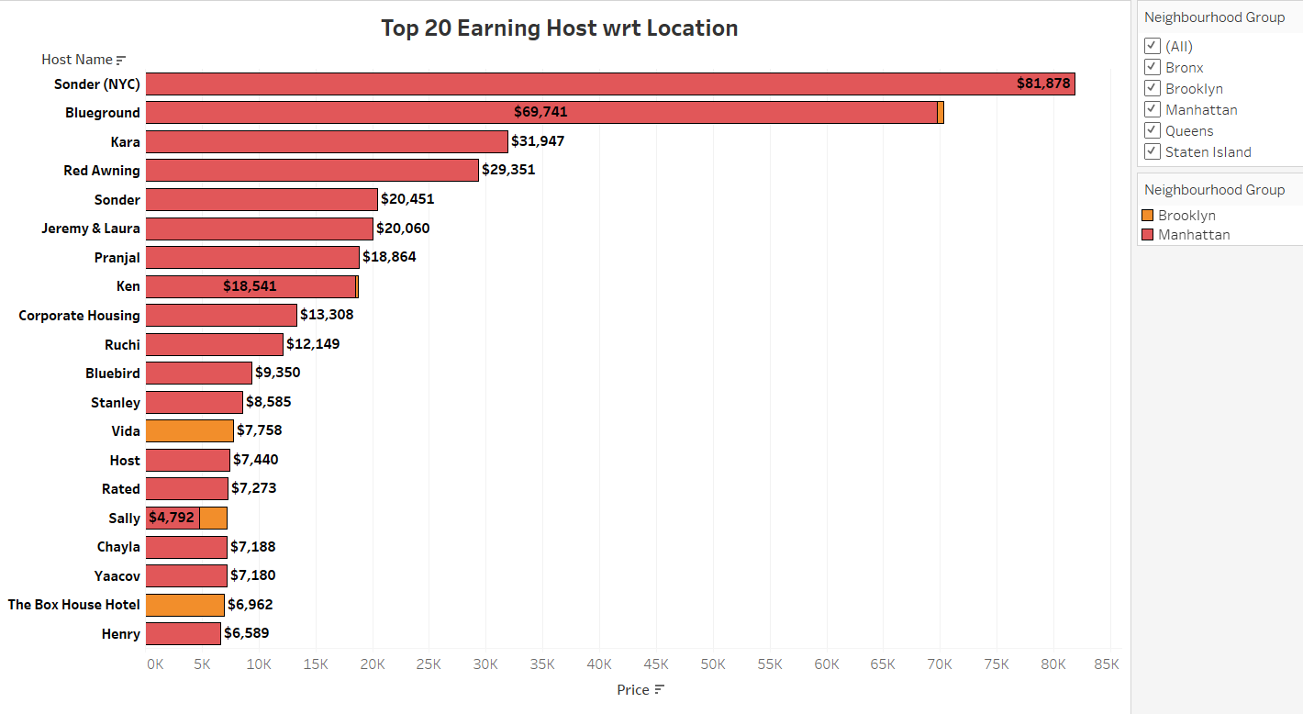
Top 20 earning host w.r.t location
Sonder (NYC) has the maximum earnings.
Manhattan has the maximum earnings in Top 20 followed by Brooklyn.
No host from Queens, Bronx & Staten Island location is under Top 20.

Slide 9
recommendation
Acquire more of Entire home/apt and Private room hosts than shared rooms as they are in demand to maximize the revenue.
We should concentrate on increasing our amount of listings per host in Staten Island and Bronx because we have very less listings on this locations and a feedback system should be reviewed in order to have more reviews from this two locations.
Focus more on those locations i.e. Manhattan & Brooklyn where the revenue generations is pretty high compared to other locations which are popular among the customers.

Slide 10
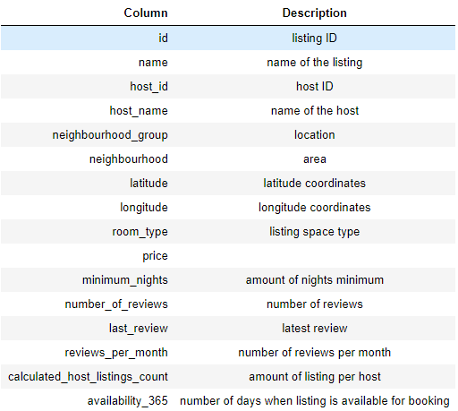
Appendix – data source
DATA SOURCE : NYC AIR-BNB data-set provided.
The data-set columns are self-explanatory.
Here is a snapshot of our data dictionary.

Slide 11
Appendix – data methodology
Data understanding, preparation and pre-processing :
Reading and Understanding data.
Treating missing values.
Treating outliers.
We used python jupyter notebook to perform this steps.
Used Tableau for data visualization for deeper analysis.
The methodology document file has been attached with it which has the overall process and snapshot of our whole analysis.

Slide 12
Appendix – data model assumptions
We assumed the data prior to the COVID - 19 period was achieving the desired revenue.
The company’s strategies are decided considering the travel will increased in the post COVID period.
After global COVID - 19 limitations are loosened the business plans will be developed in light of the anticipated increase in travel.
THANK YOU

